Slide 1


K.RAMAKRISHNAN COLLEGE OF TECHNOLOGY
(AUTONOMOUS), TRICHY.
DEPARTMENT OF
COMPUTER SCIENCE AND ENGINEERING
20CS5501 DESIGN PROJECT-1
Batch No. : 08
Date : 05.12.2024

Slide 2
IMAGE SLIDING PUZZLE GAMING
Guided by Team
Mr. R. Rajavarman Anandharaman R (811722104010)
Assistant Professor, CSE Arun K (811722104016)
Dinesh Karthik S (811722104035)

Slide 3
OBJECTIVE OF THE PROJECT
To design a captivating puzzle game that sharpens logical thinking, enhances problem-solving skills.
With dynamic challenges, visual rewards, and engaging gameplay, the game offers both mental stimulation and moments of pure enjoyment.
To encourage players to think outside the box and develop creative solutions
To inspire creativity and strategic planning through dynamic and ever-changing puzzle challenges.

Slide 4
ABSTRACT
Real-Time Features: Players can track their progress with a built-in timer and move counter, creating a sense of urgency and challenge to complete the puzzle efficiently.
Solution Assistance: The game includes an option to check the solution, allowing players to see the completed image for guidance if they need help.
Dynamic and Replayable: Random puzzle generation ensures that each game offers a unique challenge, keeping gameplay fresh and encouraging players to return for more.
Interactive Gameplay: The puzzle game is designed to engage players with an easy-to-use interface where they solve shuffled images by moving pieces into place.

Slide 5
LITERATURE SURVEY
TITLE OF THE PAPER | AUTHOR (S) | PUBLISHER | PAPER GIST | TECHNOLOGY USED
A Framework for Generating Sliding Puzzle Games | D. Coombs, A. Doyle | IEEE | Proposes a heuristic algorithm framework for creating dynamically solvable sliding puzzles. | Developed with heuristic algorithms and AI techniques like A* and iterative deepening to dynamically generate solvable puzzles. The framework is implemented using Python
Optimizing Player Experience in Sliding Puzzles Using Artificial Intelligence | J. Smith, H. Lee | Springer | Uses reinforcement learning to tailor puzzle difficulty dynamically, enhancing the player's gaming experience. | Utilized machine learning models, specifically reinforcement learning, to adjust puzzle difficulty based on player feedback.
Cognitive Load Analysis in Sliding Tile Games | A. Kumar, L. Sharma | ACM Digital Library | Analyzes player engagement and cognitive load using EEG and eye-tracking technologies to optimize gameplay design. | The game prototype was developed using JavaScript for browser-based usability and integrated with Tobii eye trackers.

Slide 6
LITERATURE SURVEY
TITLE OF THE PAPER | AUTHOR (S) | PUBLISHER | PAPER GIST | TECHNOLOGY USED
Game Design Elements in Digital Sliding Puzzles | P. Harris, M. Walker | IJHCS (International Journal of Human-Computer Studies) | Explores the integration of gamified features like leaderboards and achievements to boost player motivation. | The study implemented a gamified sliding puzzle in Unity, integrating leaderboard systems and progress bars.
A Comparative Study of Algorithms for Sliding Puzzle Solvers | R. Patel, E. Nguyen | IJCA (International Journal of Computer Applications) | Benchmarks BFS, DFS, and A* algorithms, demonstrating A*'s superior performance in solving sliding puzzles efficiently. | Benchmarked classical algorithms like BFS, DFS, and A* implemented in Python.

Slide 7
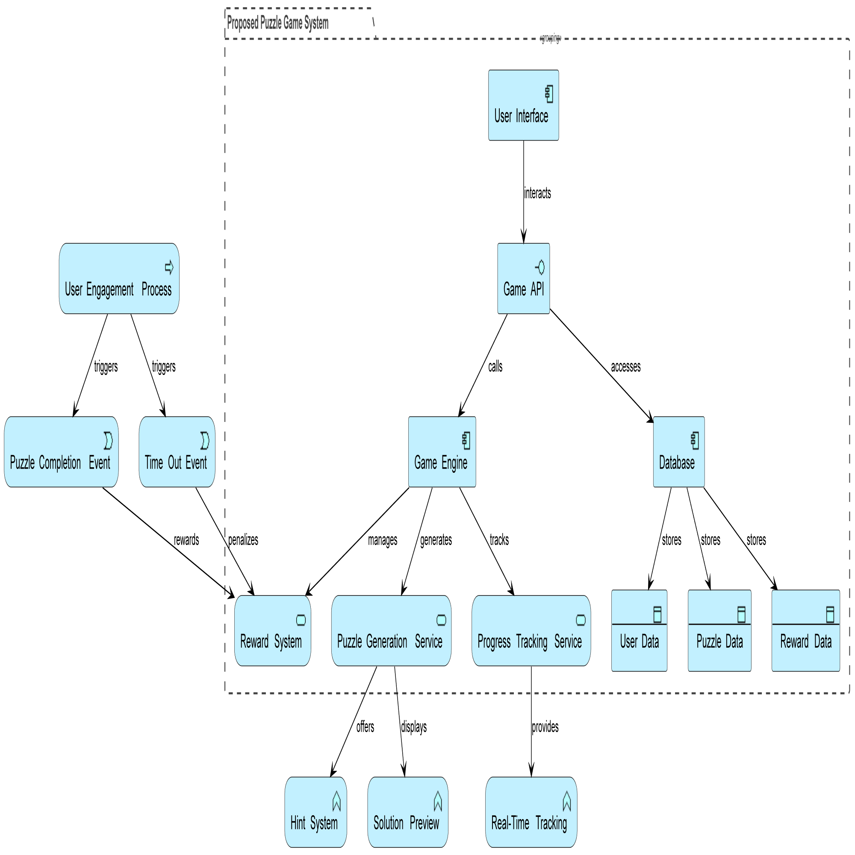
PROPOSED SYSTEM ARCHITECTURE

Slide 8
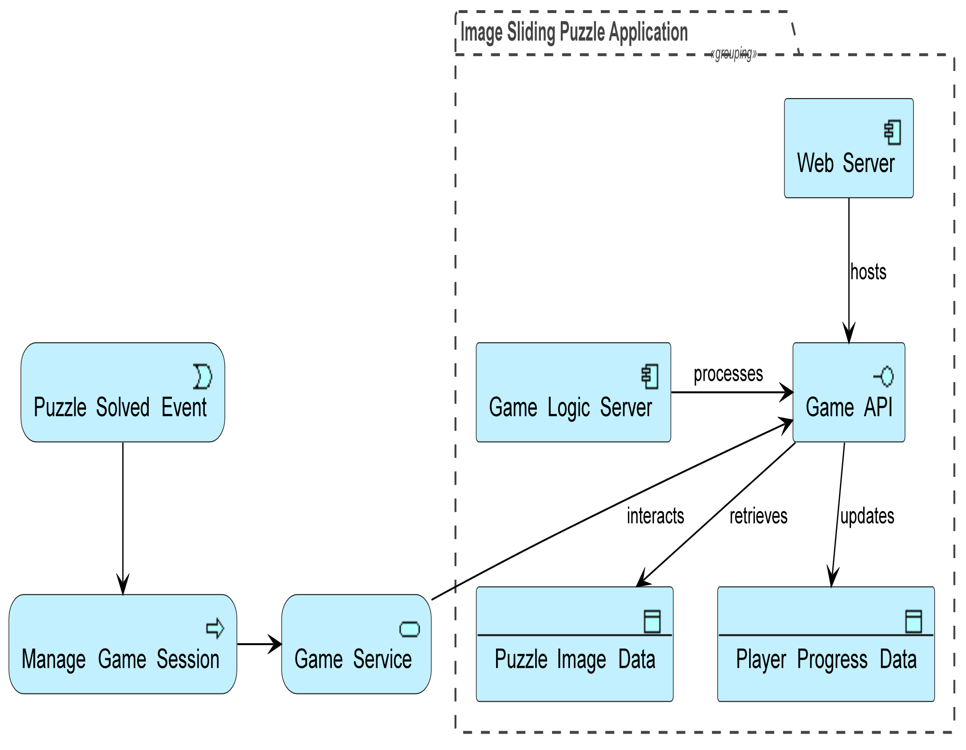
EXISTING SYSTEM ARCHITECTURE

Slide 9
SOFTWARE AND HARDWARE REQUIREMENTS
HARDWARE
SOFTWARE
Processor: Intel Core i5 or AMD Ryzen 5 (for efficient coding, running development tools, and testing)
RAM: 8 GB (to manage multiple development tools and browser tabs seamlessly)
Storage: 1 GB of free space (for storing project files, assets, and local databases)
Display: 15" or larger screen with a resolution of at least 1920x1080 (for a comfortable coding and testing workspace)
Operating System: Windows 10 / Linux
Programming Languages: HTML, JavaScript (for backend and logic), CSS
Text Editor/IDE: Visual Studio Code (for coding in HTML, JavaScript, and CSS)
Web Browser: Latest versions of Chrome, Firefox, or Edge (for testing and debugging)
Testing Tools: Browser DevTools (for debugging), live server extensions in VS Code

Slide 10
MODULES
User Interface and Profile Details Module: Manages the game layout and user profile input.
Puzzle Game Logic and Interaction Module: Handles the puzzle mechanics and player actions.
Interactive Features Module: Tracks time, moves, and provides solution help.
Winning Functionality and Message Display Module: Detects wins and shows a success message.
Rewards Section Module: Offers rewards and achievements for player progress.

Slide 11
SUMMARY OF MODULE-1
User Interface and Profile Details Module:
This module handles the design and structure of the game’s interface, ensuring it is visually appealing and easy to navigate. It provides users with an interactive main menu, puzzle grid, and other essential game elements.
The profile details section allows users to input and store personal information such as their name, date of birth, and phone number, creating a personalized experience. This module ensures that users can access and update their profile data seamlessly and feel connected to the game.

Slide 12
SUMMARY OF MODULE-2
Puzzle Game Logic and Interaction Module:
This is the core of the game, responsible for implementing the logic needed to create and solve the puzzle. It includes algorithms that shuffle the puzzle pieces in a way that ensures the puzzle is solvable.
The module handles the rules for moving pieces, checking if a piece is in the correct location, and updating the game state accordingly.
It also manages user interactions, processing clicks or drag-and-drop actions to move puzzle pieces. This module ensures the game operates smoothly and responds accurately to player inputs.

Slide 13
SUMMARY OF MODULE-3
Interactive Features Module:
This module adds essential gameplay features that enhance the user experience. It includes a timer that counts down from 2 minutes, creating a sense of urgency and competition. The move counter tracks the number of moves a player has made and displays it on the screen, adding a strategic element to gameplay.
Additionally, the solution assistance feature allows users to view the completed puzzle image if they need help, offering support when they are stuck. These interactive features keep players engaged and provide a more challenging and rewarding experience.

Slide 14
SUMMARY OF MODULE-4
Winning Functionality and Message Display Module:
This module is responsible for detecting when a player has successfully completed the puzzle. It includes logic that checks if all pieces are in their correct positions and triggers a win condition. Once the puzzle is solved, this module displays a congratulatory message or animation, acknowledging the player's success.
The module also handles transitions to a winning screen, allowing players to see their final score or achievements. This feedback helps create a sense of accomplishment and motivates players to play again or strive for better scores.

Slide 15
SUMMARY OF MODULE-5
Rewards Section Module:
This module is designed to provide players with incentives for their performance and progress. It includes a system for awarding achievements based on milestones such as completing the puzzle within a specific time limit, using fewer moves, or solving the puzzle without hints.
The rewards can range from in-game trophies and badges to special content or unlockable features. This module enhances player engagement and motivation, encouraging them to return and play more by providing a sense of progression and accomplishment.

Slide 16
RESULTS AND DISCUSSION
Results:
The Image Sliding Puzzle game was developed successfully and met its objectives, offering an engaging and interactive experience for users.
Key features, including the 5-minute timer, move counter, and solution-checking button, were implemented and functioned as expected.
Players were able to track their progress in real-time and solve the puzzle, adding excitement and motivation to complete the challenge.

Slide 17
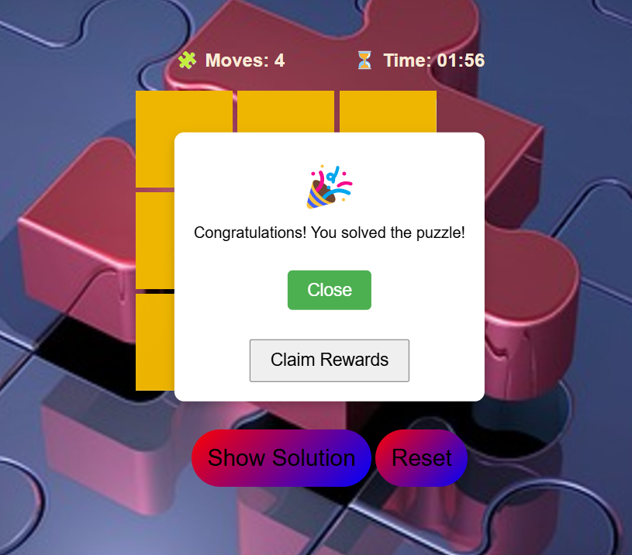
RESULTS AND DISCUSSION

Slide 18
RESULTS AND DISCUSSION
Discussion:
The project allowed us to improve our skills in web development, including JavaScript for interactive game mechanics, CSS for styling, and HTML for layout.
During development, we faced challenges such as ensuring that the puzzle shuffling algorithm created solvable puzzles.
One of the primary difficulties was adding the winning functionality and ensuring it worked correctly.
Another challenge was creating an efficient algorithm for shuffling the puzzle pieces while ensuring that the puzzle remained solvable.

Slide 19
CONCLUSION
In conclusion, the development of the Image Sliding Puzzle project has provided valuable experience in game development and web design.
Through building and refining this game, we gained insights into designing user-friendly interfaces.
This project allowed us to tackle challenges such as creating a responsive layout, ensuring smooth functionality, and integrating real-time tracking features like timers and move counters.
Overall, this project has been a rewarding journey that deepened our understanding of game development and the importance of creating an enjoyable, intuitive user experience.

Slide 20
THANK YOU

